Slide 1
Low code development
Pravin Y Pawar

Slide 2
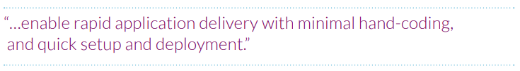
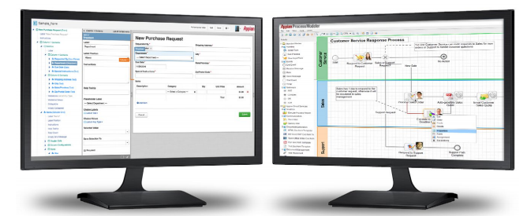
What is low code?
Low-code development is a way to build apps more quickly by reducing the need to code
According to Forrester Research, low-code development platforms:
Low-code development has evolved to take advantage of visual design tools like
drag-and-drop modelers
point-and-click interface creation
—to enable the rapid creation, launch, use and change of powerful business apps

Slide 3
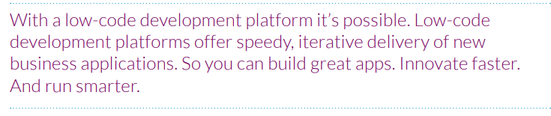
But why did low-code come about?
In a word, mobile…
The explosion of mobile, and the resulting change in consumer and (even) employee expectations
The sheer demand for digital services is growing faster than ever, and it does not appear to be slowing anytime soon
And considering the hundreds, if not thousands of disjointed processes, systems, apps, solutions, etc. at any given organization
not surprising that even brands considered to be leaders struggle to keep pace.
So, how do you get ahead of the new digital expectations?
And how can you possibly stay there, with the incredible pace of change?
What if your IT organization could deliver solutions FASTER with FEWER RESOURCES?

Slide 4
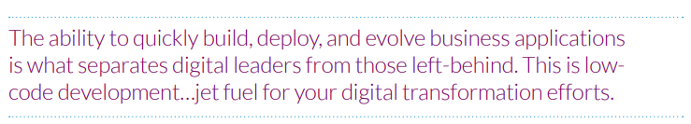
LOW-CODE: TRANSFORM IDEAS TO INNOVATION
The fastest way to transform ideas into innovation
These platforms break down the traditional barriers between business and IT
allowing the rapid build, launch, and modification of powerful apps
This model-driven development approach:
Speeds app creation
Unites legacy systems
Gets ahead of Shadow IT
Fosters the agile Business/IT collaboration needed to realize digital transformation’s massive potential

Slide 5
DO I NEED LOW-CODE?
Signs where you could benefit from using a low-code development platform:
Keeping up with demands from the business is difficult
IT organization is constantly slammed with demands from the larger organization
The IT backlog is large… and perpetually growing. IT is falling behind.
Reliance on legacy apps
Legacy applications drain efficiency… and your IT resources
They keep talented IT resources in a continual state of updates and fixes
More time spent on maintenance than innovation
most IT teams spend nearly 80% of their time on maintenance, and only 20% on new innovation
Too little time focused on innovative solutions leads to …
Shadow IT
Employees don’t wait for IT
They’re creating their own solutions—that are not a part of your architecture—in a world of Shadow IT that adds even more complexity to your business
Scarce development resources
You urgently need top-notch software developers
But it’s getting increasingly harder to find and retain them

Slide 6
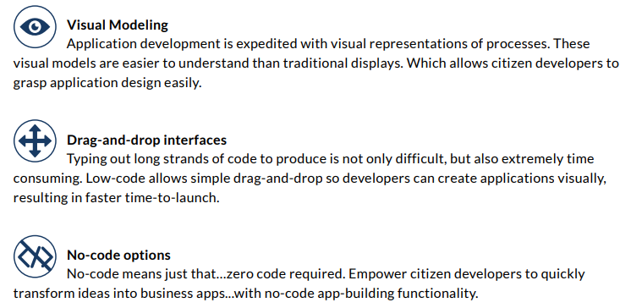
Key features of low-code

Slide 7
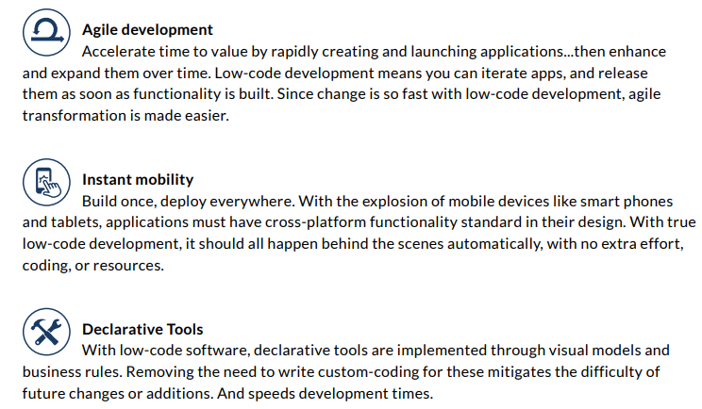
Key features of low-code (2)

Slide 8
Thank You!
Reference:
Appian Low code Guide
In our next session:

